Slide 1
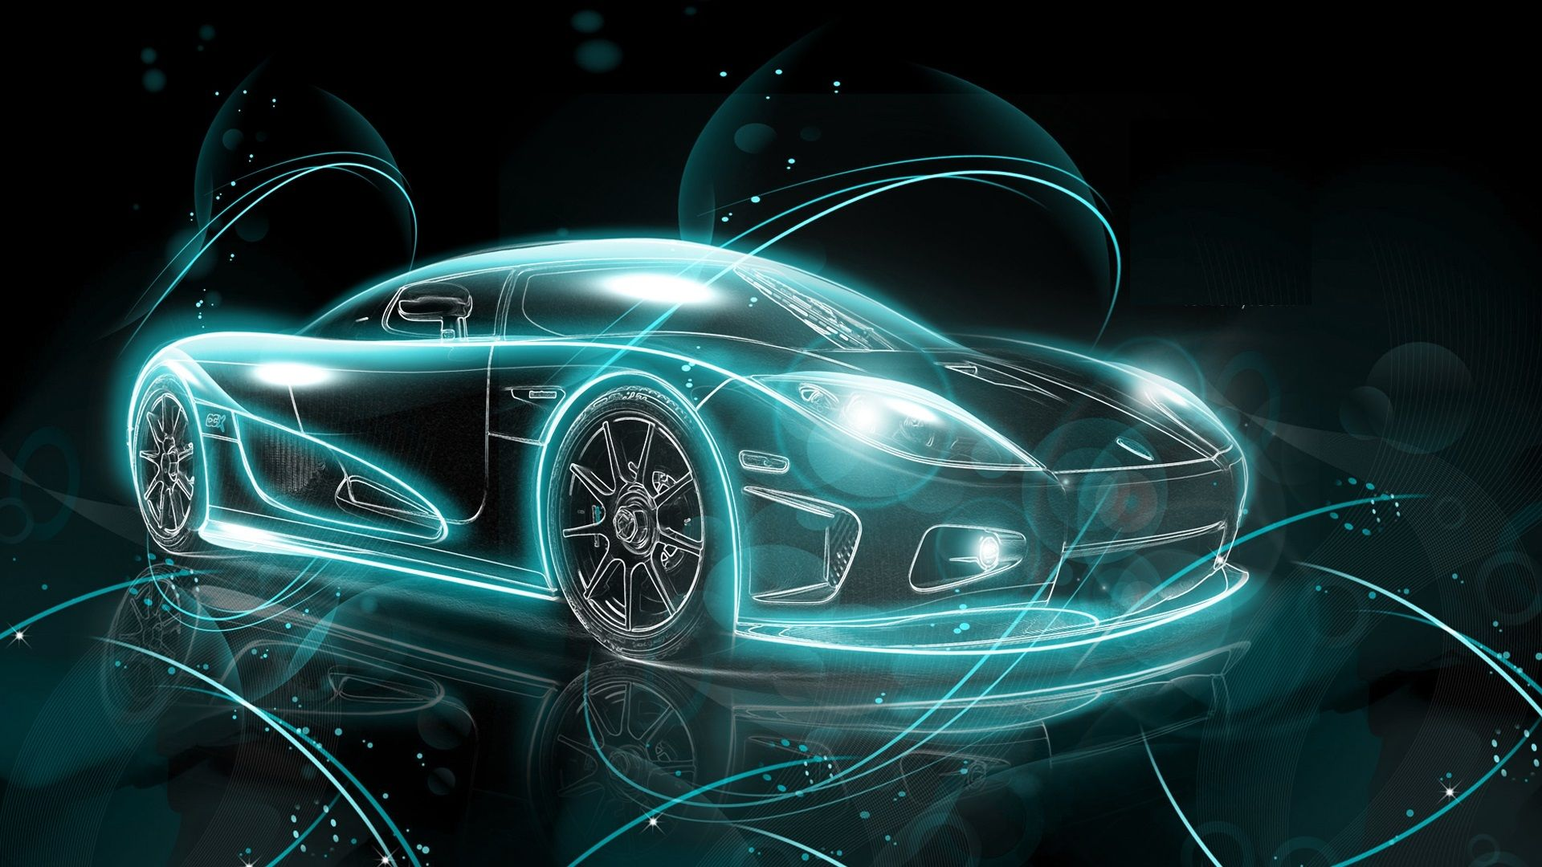
19CSE100_PSAT DESIGN CHALLENGE
CLASS : ECE-A
GROUP 11
TEAM MEMBERS :
C RISHI VARDHAN REDDY (1013930)
D SANTHOSH (1035465)
Arvind La (1010498)
KASINA SAI SURYA VAMSI (1041371)
K Gokul Prasad (1006754)

Slide 2
VIRTUAL CAR
Design a virtual car which switches between ‘states’ according to the inputs fed by a virtual driver, thereby simulating the working of an actual car

Slide 3
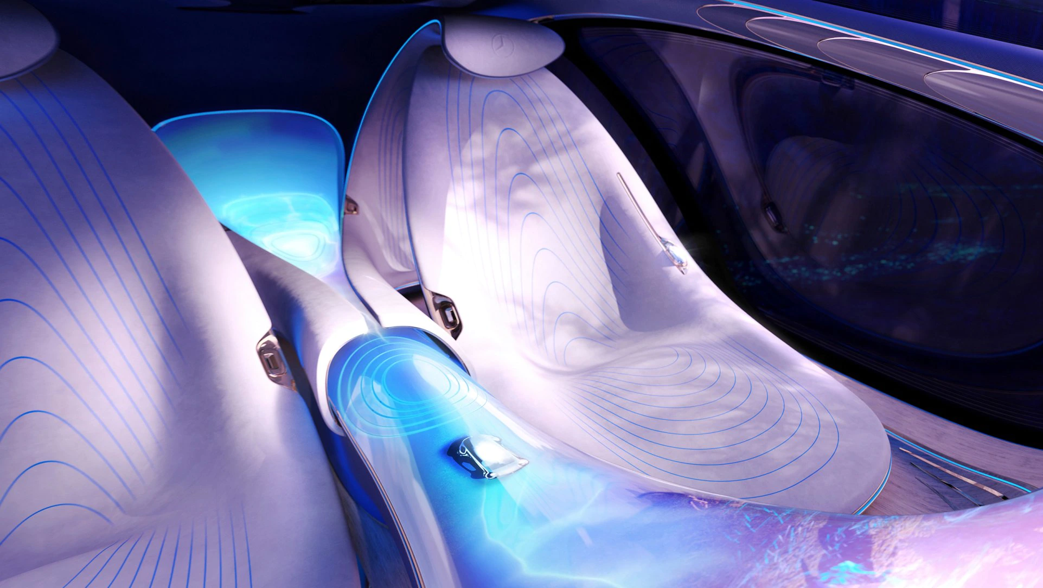
Virtual Car
Design a virtual car which switches between ‘states’ according to the inputs fed by a virtual driver, thereby simulating the working of an actual car

Slide 4



PROBLEM STATEMENT
2)Provides just the right data to supplement the AI that's fueling the current autopilot systems, which is in dire need of human driving analysis and driver metrics.
Design a virtual car which switches between “states” according to the input fed by a virtual driver, thereby simulating the working of an actual car
1)Assists a wide spectrum of people from learning how to learn to drive initially to those who are training for their profession.

Slide 5


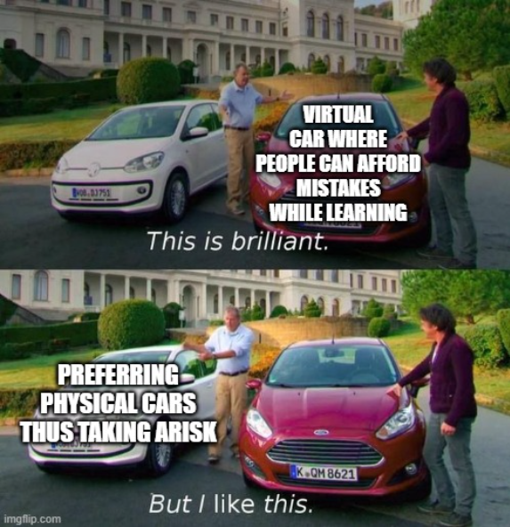
AIM :
Design a virtual car simulating the functioning of a real car by switching between “states"
Pull the people away from the traditional beliefs of learning to drive
CHALLENGES :
People being staged in their comfort zones of learning driving, and thus wouldn't accept anything unless its revolutionary
People in their comfort zones of learning to drive physically be like:

Slide 6

To produce trained drivers while minimizing any human errors while learning in driving schools to reduce the number of accidents
To train professional drivers (Ambulance drivers and racers) to the extreme real world demands without risking their life
To make the technology easy to access for the general public

Slide 7
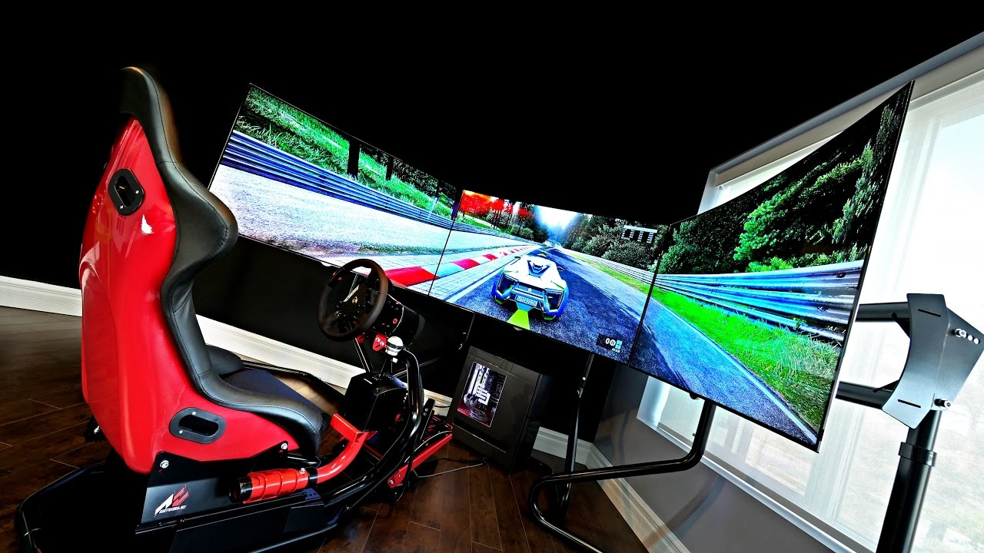
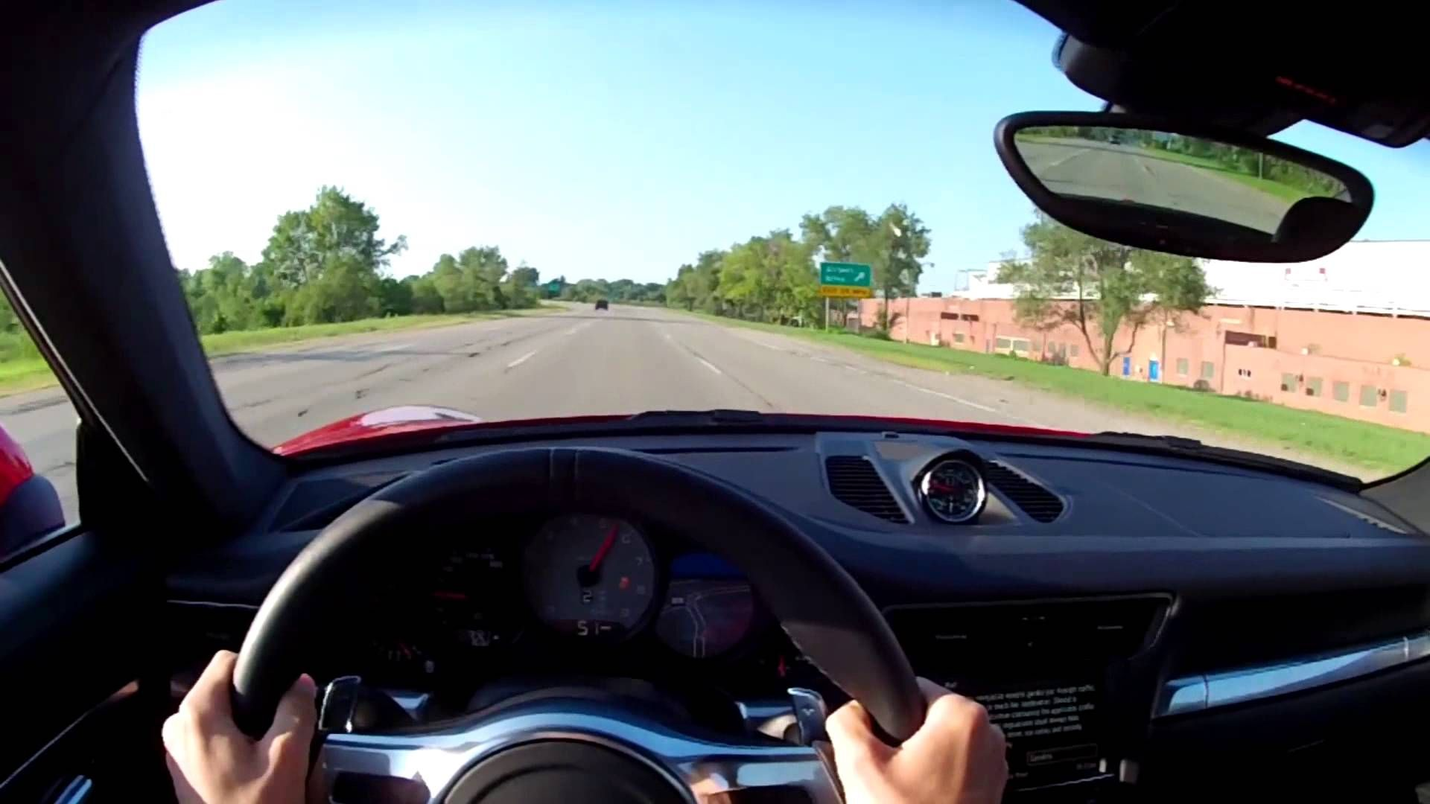
REQUIREMENTS:
Right level of a Machine learning code to perfectly simulate the real world driving conditions
An Advanced virtual reality headset to plunge us into the virtual environment
The mechanical and rotary 4D equipment to form the cherry at the top.

Slide 8
ALTERNATE SOLUTIONS
The only other solution in training the drivers is to train the learners more rigorously and intensively, providing them with clear instructions, but that's what we've been doing all these decades but in vain.
EDGE OVER THE ALTERNATE SOLUTION
The biggest challenge in the alternate solution is the basic human tendency to commit errors, which sometimes lead to devastating consequences especially in our domain.
In the proposed solution, even with human errors, the consequences are virtually ZERO.

Slide 9

HOW DO WE SAY THAT IT IS IMPLEMENTABLE?
SOFTWARE SIDE :
Already Some Games From EA-Motor Sport And Forza have been optimized for Virtual reality
So the procedure to code such a software/prototype is relatively easy as we have the pre-existing models already in the market
HARDWARE SIDE :
The Design almost matches with the physical Boeing Airplane Simulators
We just have to integrate both and tweak them a little to have our implementation part right there

Slide 10

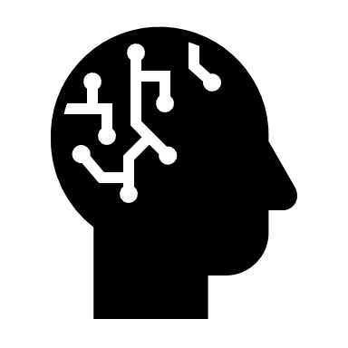
Efficiency and practicality
Practicality Reasons:
Buying and maintenance of computer vs Physical car is less
The only investment is the upfront cost of purchase as there's virtually no cost of running needed except electricity bills
Not everyone need to own these machines as they'd be only present only in the driving schools
In case of efficiency the only requirements are a powerful Computer and a VR headset which will obviously cheaper than a decent car and this need not be owned by everyone so it can be hired for a specific time at certain practice centers

Slide 11
BOUNDARY CASES
Simulating human behavior in the virtual environment :
This can be solved by a proper AI/ML code as if one can teach an NPC(Non-Player candidates) how to follow the rules, same can be done to teach them how to not follow the rules sometimes, thus mimicking real world human behavior
2)In case of an accident by the human
There is ZERO physical damage as the entire environment is virtual and lets assume the computer crashes of the workload, the cost of repairing the computer is far less than the costs for the physical damage incurred to both the humans and the car.

Slide 12
STATES AVAILABLE IN THIS VIRTUAL CAR
MODES
MANUAL
PARK
REVERSE
AUTOPILOT
DRIVE
FUEL EFFICIENCY
CRUISE
SAFETY
TURBO

Slide 13
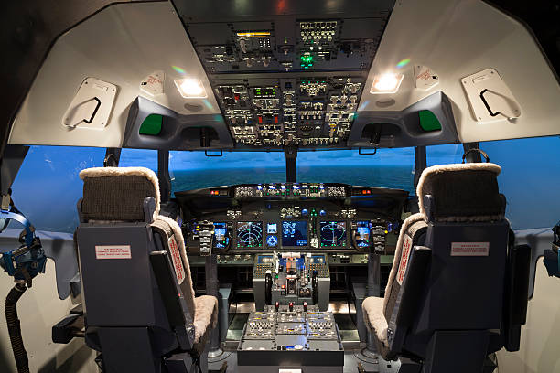
REAL LIFE PROBLEM
BOEING SIMULATORS:
Aircraft industry is appropriate with all it’s ups and downs and safety has become a key factor for it.
It’s the reason why all the aircraft companies Such as BOEING have invested in such a similar technology called “VIRTUAL COCKPIT”
This is implemented in order to nullify the human errors
This is an advanced version of the same “VIRTUAL CAR” to adapt to the extreme conditions above thousands of feet in air

Slide 14
Bibliography
https://flightexperience.com/pages/boeing-737-flight-simulator
https://automotive-transportation.basf.com/global/en/automotive/stories/virtual-car-drives-mobility-industry-forward.html
https://www.oculus.com/
Image credits :
https://www.dreamstime.com/
https://www.vectorstock.com/

Slide 15

For your attention and trusting us with this project…

